Slide 1


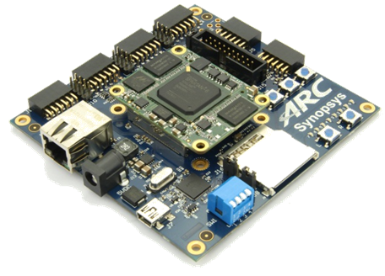
領先創新·
·超越自我
2019 Synopsys ARC盃電子設計競賽

Slide 2

SMART FIREFIGHTER
UETer: DANG Hai Ninh & VU Huong Giang
VNU Key Laboratory for Smart Integrated Systems (SISLAB)
VNU University of Engineering and Technology (VNU-UET)
August 2019

Slide 3

Agenda
Motivation and objectives
Design implementation
Test results
Conclusion

Slide 4
Agenda
Motivation and objectives
Design implementation
Test results
Conclusion

Slide 5
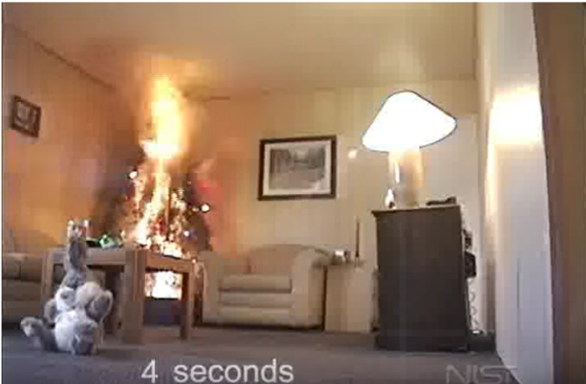
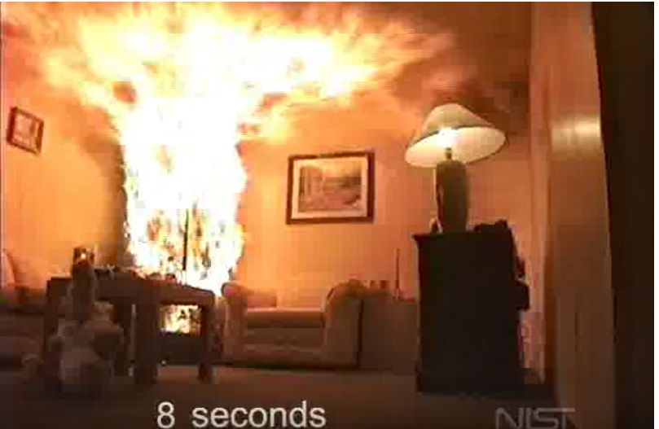
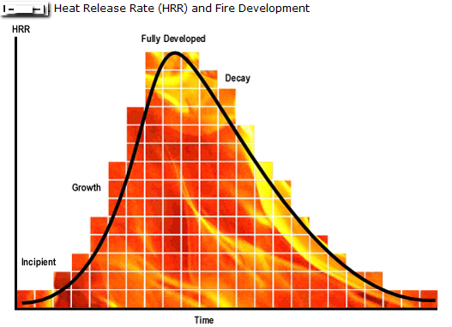
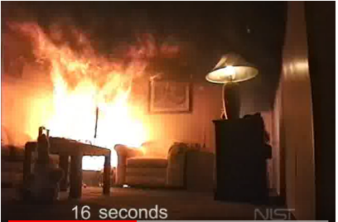
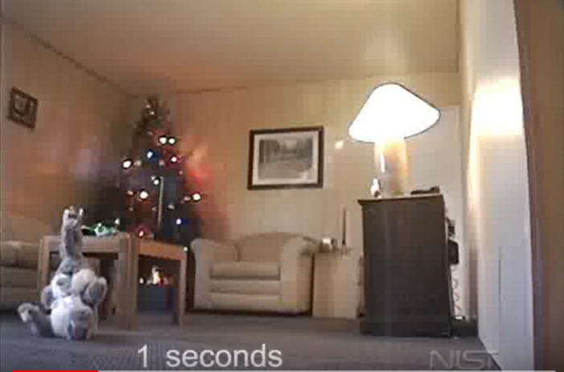
Motivation
8 seconds
4 seconds
16 seconds
1 second
NIST, “Dry Scotch Pine Tree Fire”, source: https://www.youtube.com/watch?v=fsaLCdC3iWw
Quick methods to identify and extinguish fire saving lives and properties

Slide 6
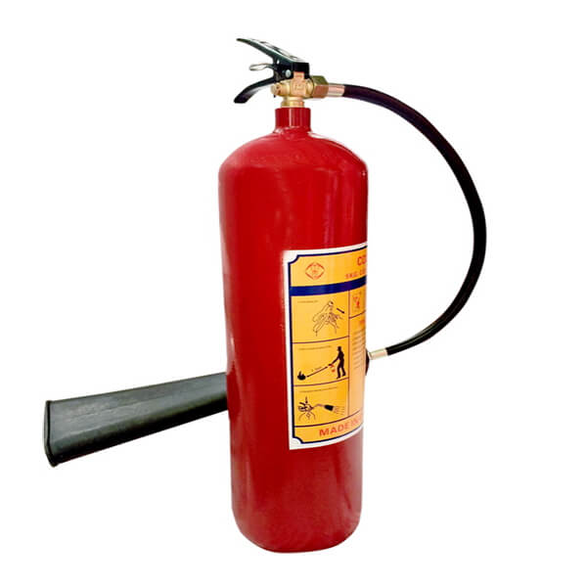
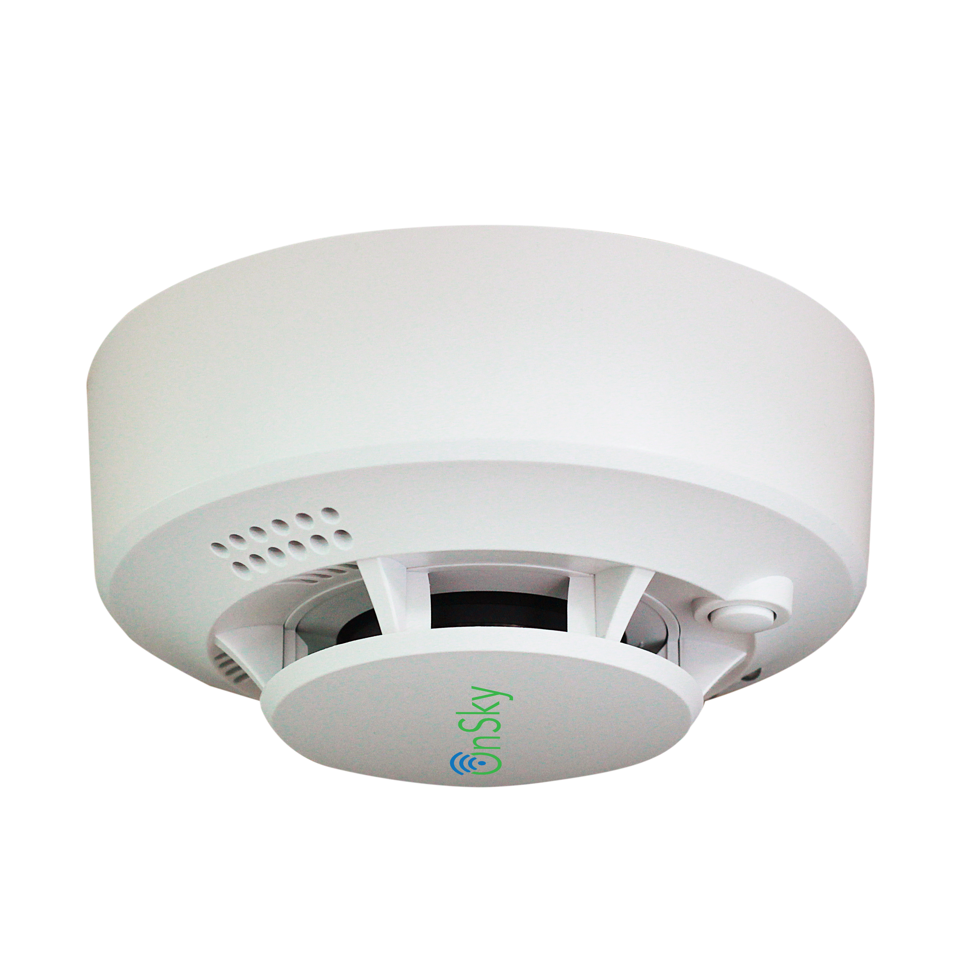
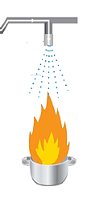
Motivation (cont.)
Traditional methods
Industrial Smart firefighter
Quick and accurate detection of flame location
Spraying water flow to the fire correctly, while keeping other areas dry
Mobility
Expensive
Fire extinguisher
Heavy
Limited visibility
Smoke sensor:
Slow detection
No location of flame
Wide water spray nozzle:
Waste water
Causing damage to other furniture

Slide 7
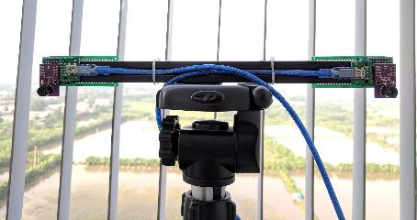
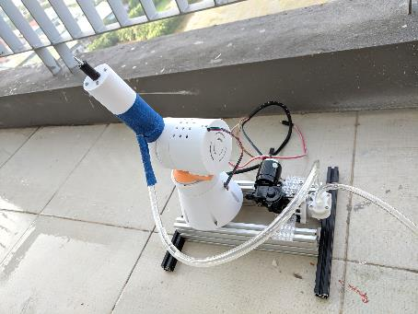
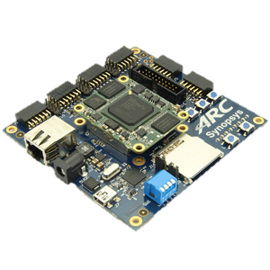
Our objective: low-cost smart fight fighter
Fire detection: Low-cost InfraRed Sensors
Autonomously detect and extinguish the fire
Useful in certain types of incidents where the environment will be very dangerous for the humans
3D-printed robot arms
Warning of danger, usually a loud noise
ARC EM Starter kit-based algorithms & controls

Slide 8
Agenda
Motivation and objectives
Design implementation
Test results
Conclusion

Slide 9
Processing flow

Slide 10
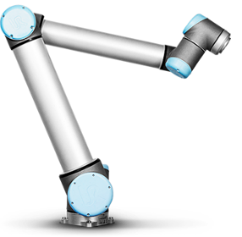
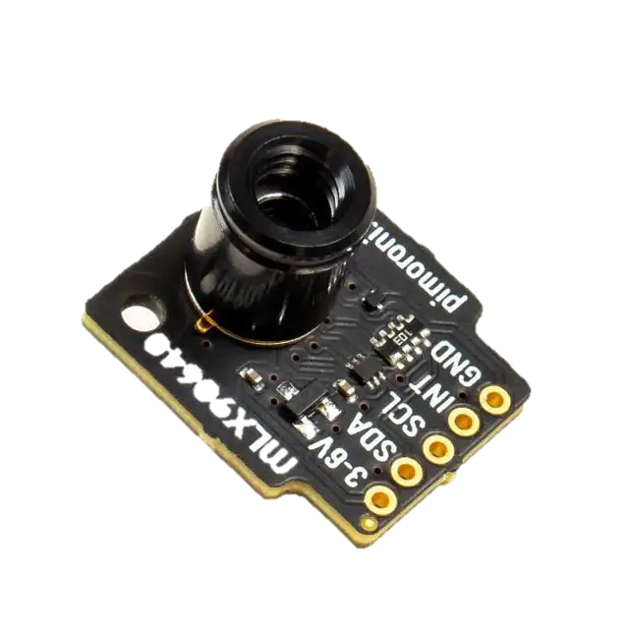

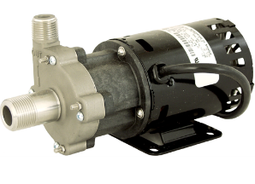
System components
2 stepper motor
UART
Move spray nozzle
Flame directions
2 axis robot arm
UART
H bridge
Flame directions
Spray water
Calculate flame locations
Water pump
2x thermal sensor 32x24 pixel
FOV: 55°x35°
ARC EM Starter Kit
Two low-cost Infrared sensors
3D-printed robot arms controlled by step motors
One water pump

Slide 11
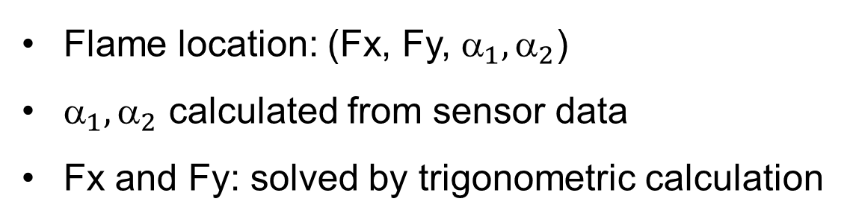
Flame Detection
Angle calculation from sensors
Detection range: 4m x 4.4m x 4.4m
Hottest pixel: xh = 2, yh = 1
- X angle: α = (55/32)*xh
- Y angle: β = (35/24)*yh
- 2 sensor: α₁, α₂, β₁, β₂
Flame location: (Fx, Fy, ${\text{}}_{1},{\text{α}}_{2}$)
${\text{}}_{1},{\text{α}}_{2}$ calculated from sensor data
Fx and Fy: solved by trigonometric calculation

Slide 12
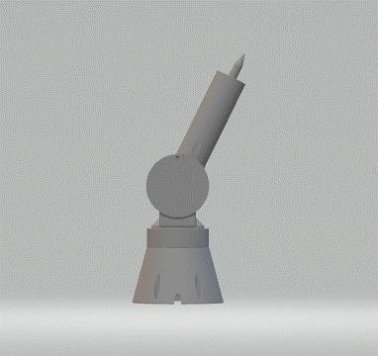
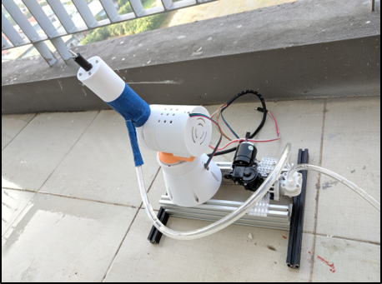
3D-printed robot hand for spraying water
Robot arm 3D model
3D-printed robot arm with two step motors
Extinguish fire by using a robot hand with two joints to spray water to the position of fire

Slide 13
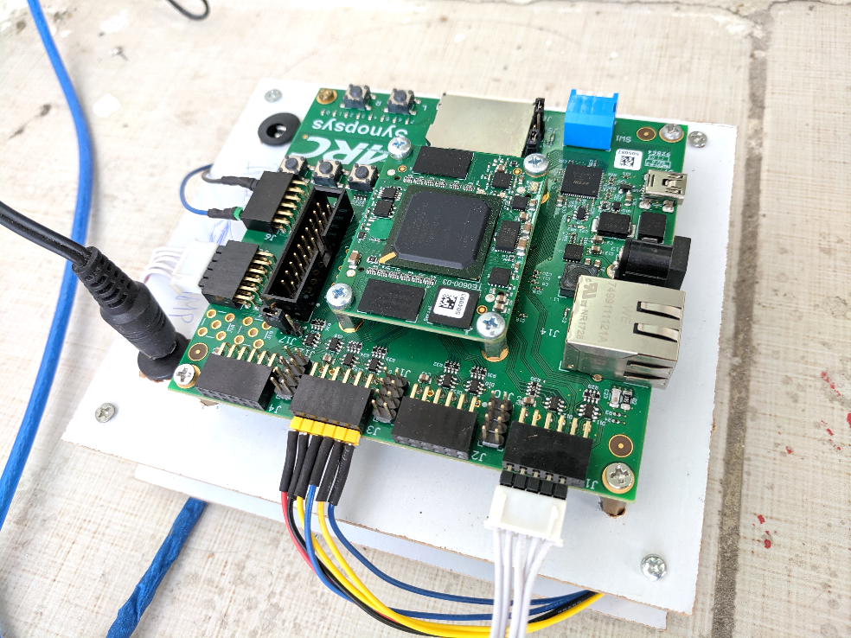
ARC EM Starter Kit connections
J6 : Relay module for water pump control
J3 : 2 Stepper driver module.
J1 & J5 : 2 IR camera module (using UART).

Slide 14
Agenda
Motivation and objectives
Design implementation
Test results
Conclusion

Slide 15
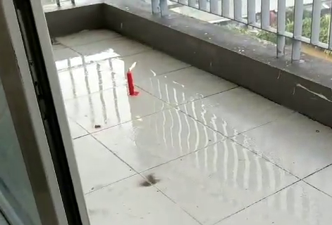
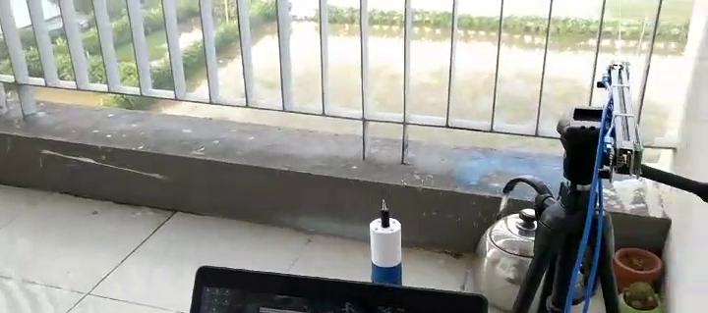
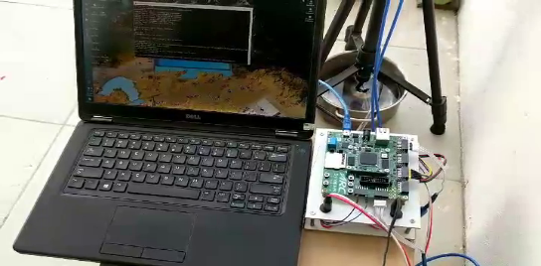
Demonstration setup
IR Sensors
Robot arm
ARC EM Starter kit
Fire: a candle

Slide 16
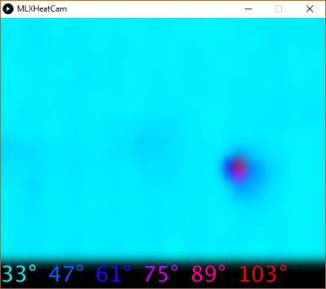
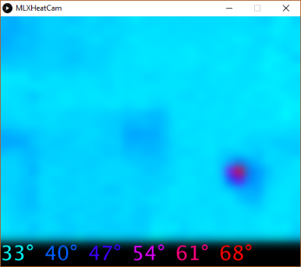
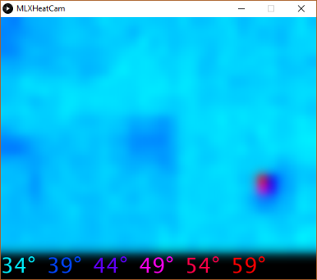
Candle flame visualization using a single sensor
Distance: 1m
Distance: 2m
Distance: 3m

Slide 17
Agenda
Motivation and objectives
Design implementation
Test results
Conclusion

Slide 18
Conclusions
Fire grows very fast in home environment & Industrial smart firefighters are very expensive
Our proposal: Low-cost Smart Fire Fighter
Low-cost IR sensor for fire detection
3D-Printed Robot arm for water control for extinguishing fire
Using ARC EM Starter Kit for algorithm development & control
Future works
Multi-sensor nodes with wireless connections
Embedded AI for fire classification

